Slide 1

Sigmoid Neuron

Slide 2
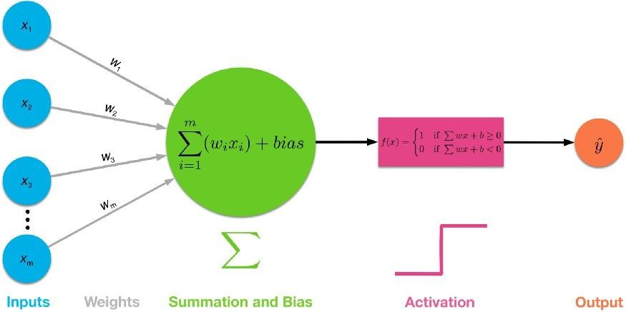
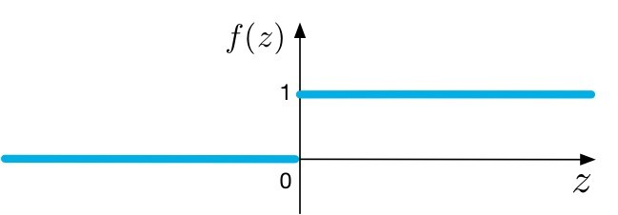
Procedures of a Single-layer
Perceptron Network
Step -Activation Function
Courtesy: towardsdatascience.com

Slide 3
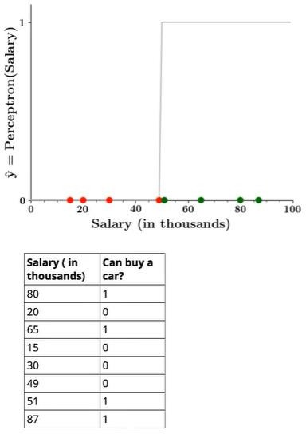
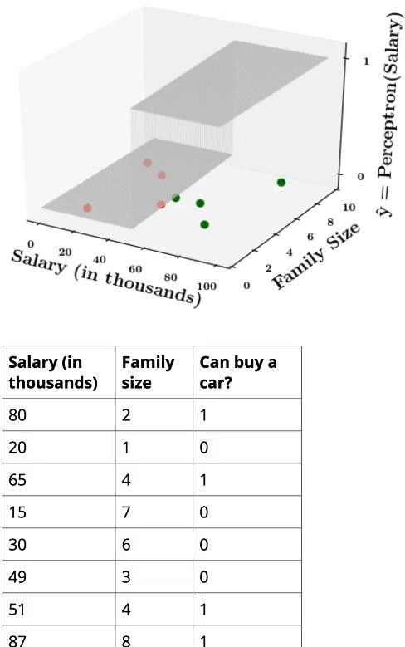
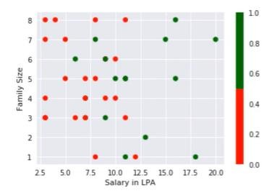
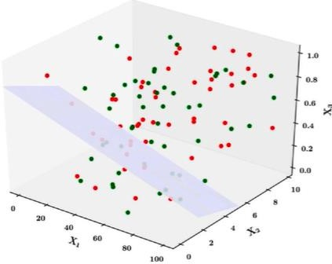
Limitations of Perceptron
1D
How about these? Non linearly separable data?
2D

Slide 4
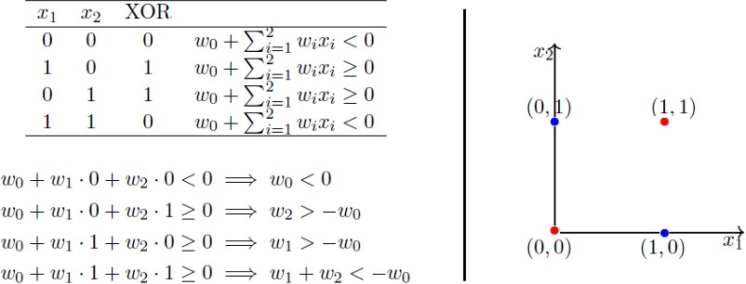
XOR Function — Can’t Do!- Non Linearly separated data
Notice that the fourth equation contradicts the second and the third equation. Point is, there are
no perceptron solutions for non-linearly separated data. So the key take away is that a single perceptron cannot learn to separate the data that are non-linear in nature.

Slide 5
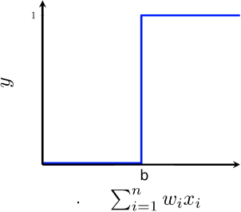
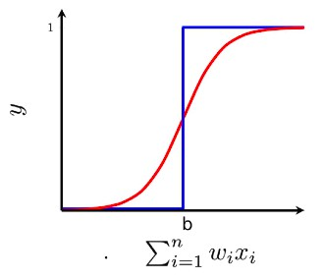
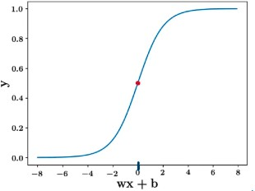
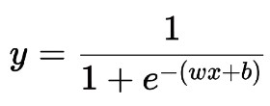

Sigmoid Neuron-
The Sigmoid Function curve looks like a S-shape.
A smoother activation function
The function is differentiable.That means, we can find the slope of the sigmoid curve at any two points. It is monotonic
It exists between (0 to 1). especially used for models where we have to predict the probability as an output.
Step function Sigmoid function
So the output is σ(w⋅x+b), where σ is called the Sigmoid Function and is def
ined
by:-
A monotonic function is a function which is either entirely nonincreasing or nondecreasing.

Slide 6

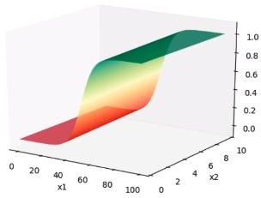
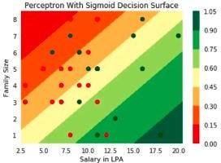
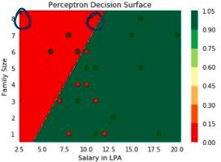
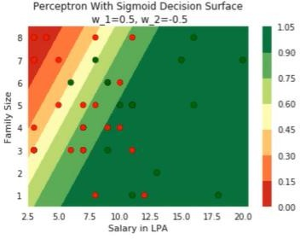
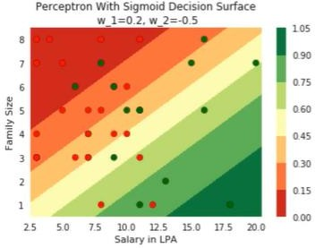
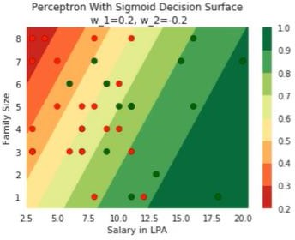
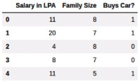
Sigmoid -2D

Slide 7
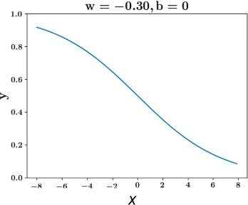
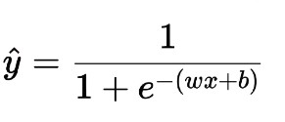

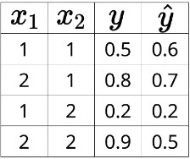
Loss Function-Sigmoid

Slide 8
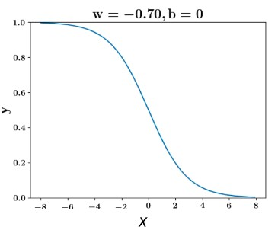
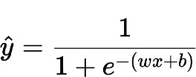
Loss Function-Sigmoid

Slide 9
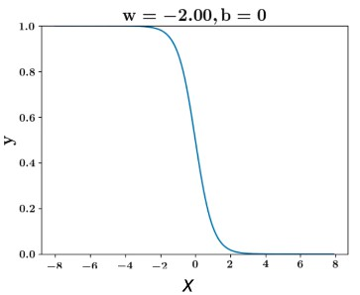
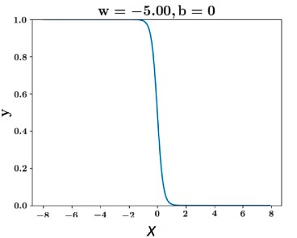
Loss Function-Sigmoid

Slide 10
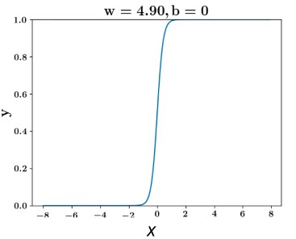
Loss Function-Sigmoid

Slide 11
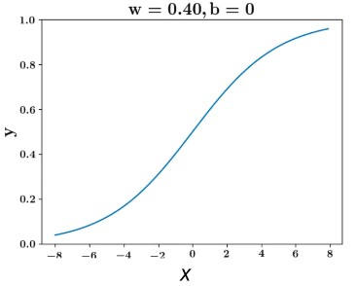
Loss Function-Sigmoid

Slide 12
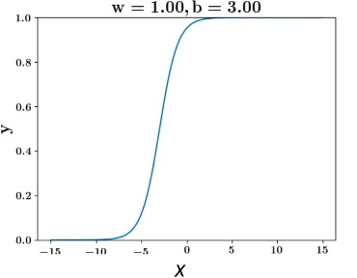
Loss Function-Sigmoid

Slide 13
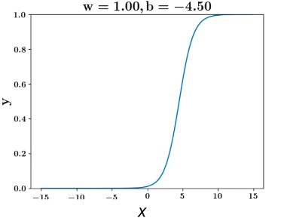
Loss Function-Sigmoid

Slide 14
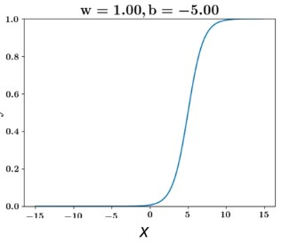
Loss Function-Sigmoid

Slide 15
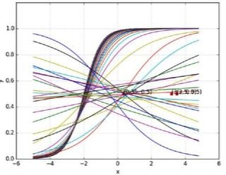
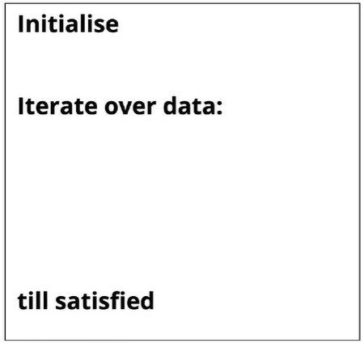

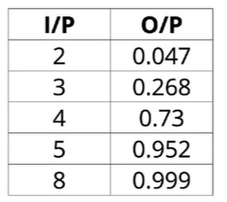

Learning Algorithm
Calculate
Try to minimize y- with
loss function
with sigmoid
Update w and b
How to update is the next question
•
𝐦𝐢𝐧
𝒘,𝒃

Slide 16
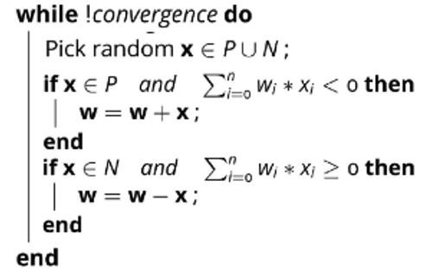
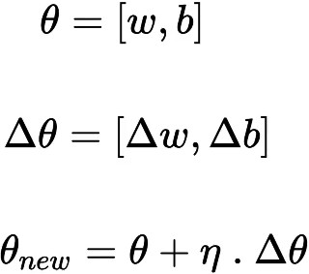
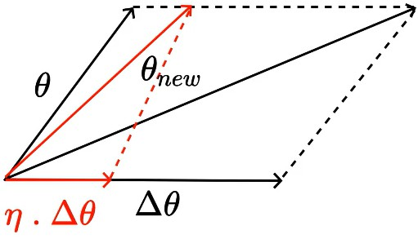
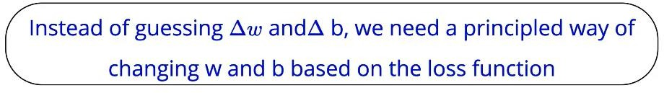
Learning Algorithm

Slide 17
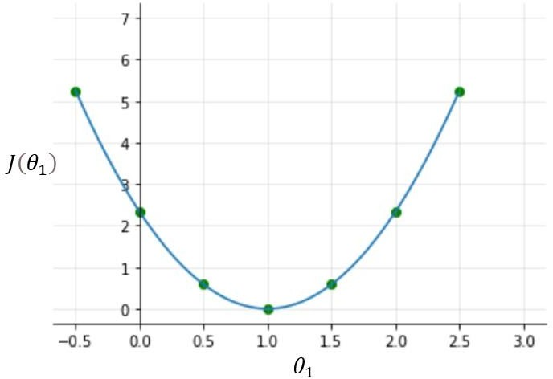
Gradient descent optimization
Gradient Descent is the process of minimizing a function by following the gradients of the cost function. This involves knowing the form of the cost as well as the derivative so that from a given point you know the gradient and can move in that direction, e.g. downhill towards the minimum value.
Once you plot these all dots, the
cost function will look like a bowl- shaped curve as shown in the figure below.
it is clear that the cost function is minimum at theta1=1 or at the bottom of the bowl-shaped curve. The purpose of all this hard work is not to calculate the minimum value of cost function,
Value of the parameters, for the minimum cost function.
In machine learning, a gradient is a derivative of a function that has more than
one input variable.

Slide 18
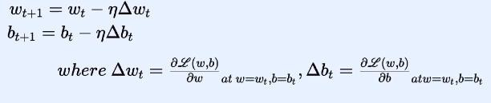
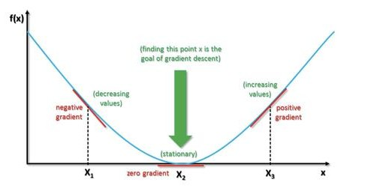


To find the local minimum of a function using gradient descent, we must take steps proportional to the negative of the gradient (move away from the gradient) of the function at the current point
Gradient Descent
A gradient measures how much the output of a function changes if you change the inputs a little bit.
Parameter Update rule
𝐦𝐢𝐧
𝒘,𝒃
Is the partial derivative of the Loss function w.r.t w.
It can be proved that with this updation in weight and b parameter, the new Loss will be less than the old loss

Slide 19
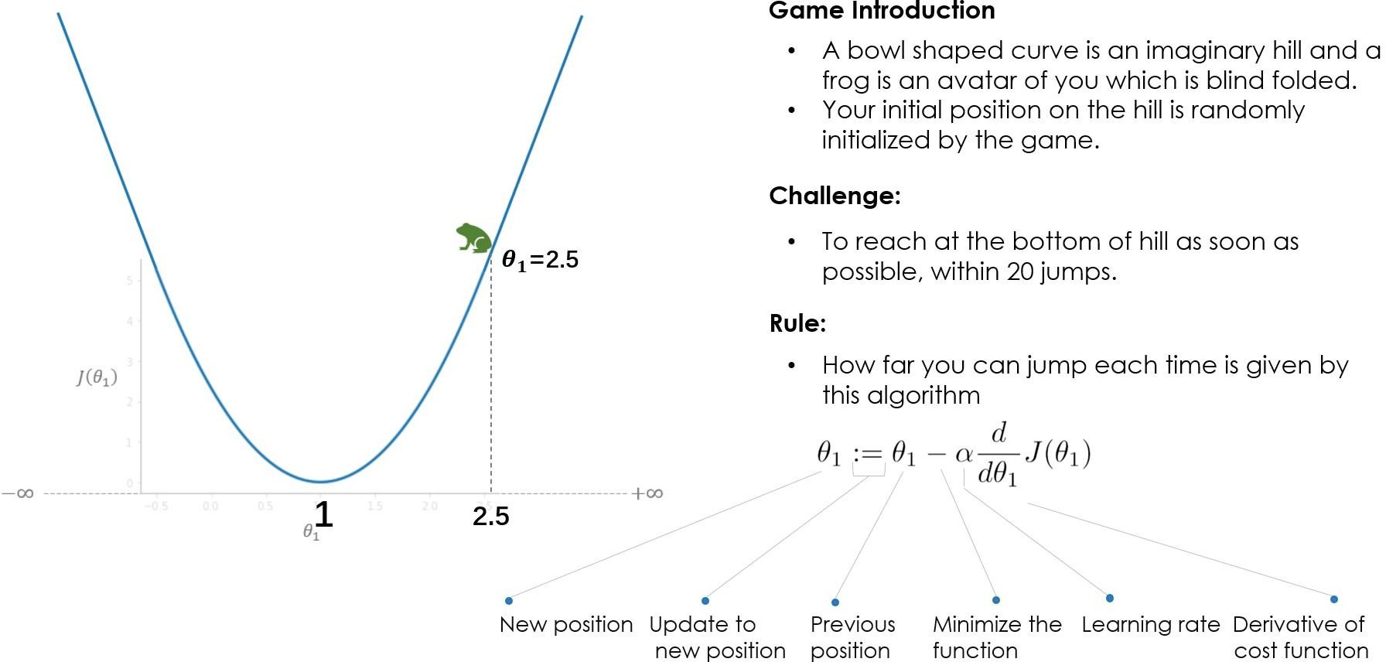
Gradient descent optimization
Alpha learning rate

Slide 20
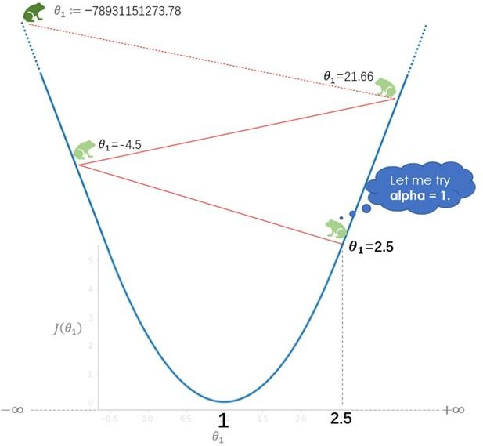
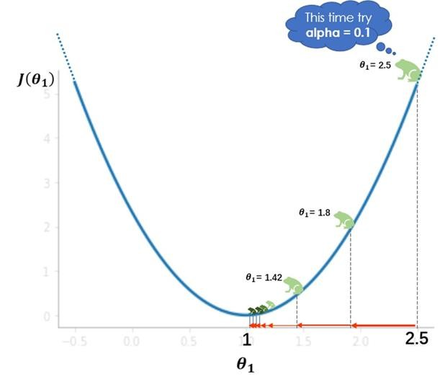
Gradient descent optimization

Slide 21
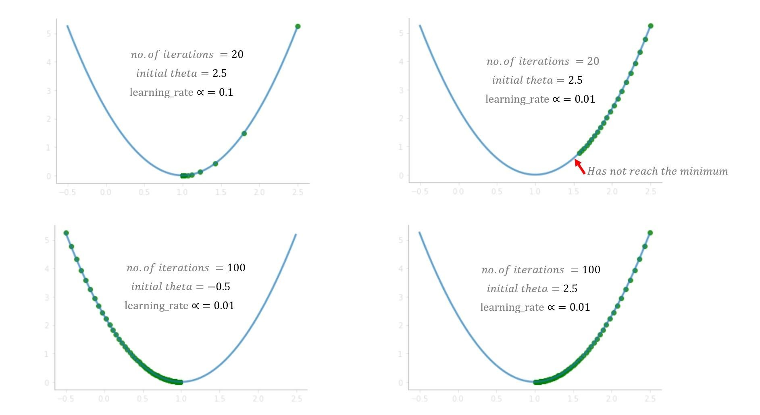
Gradient descent optimization –

Slide 22
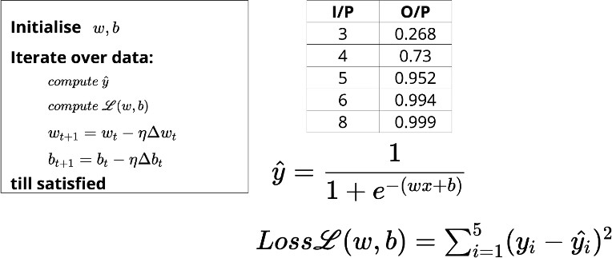
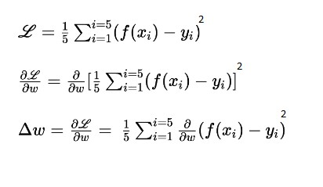
f(x) is the sigmoid function – the output

Slide 23
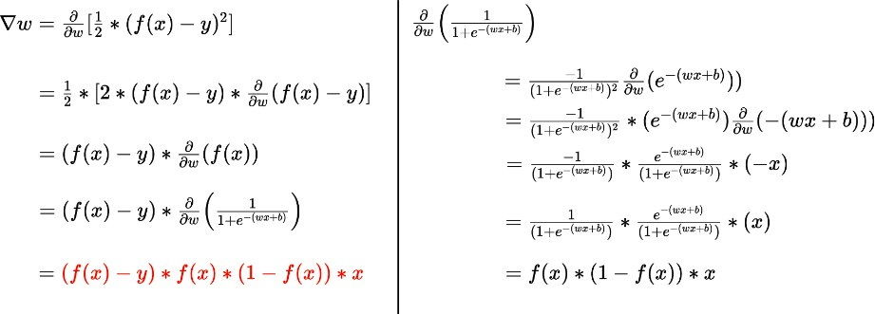
Calculation of

Slide 24
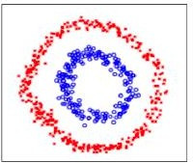
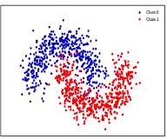
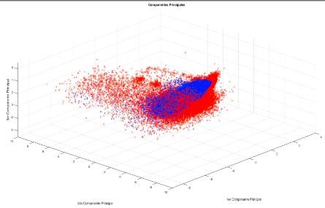
Non linearly separated data

Slide 25



Non linearly separated data

Slide 26


Will Sigmoid work ??

Slide 27

Will Sigmoid work ??

Slide 28

Will Sigmoid work ??

Slide 29

A complex function like this works

Slide 30


Need of DEEP ML models- complex real world functions
In real life, we deal with complex functions where the relationship between input
and output might be complex, unlike the simple sigmoid neuron or perceptron.

